Slide 1
Simple Camera Publisher

Slide 2
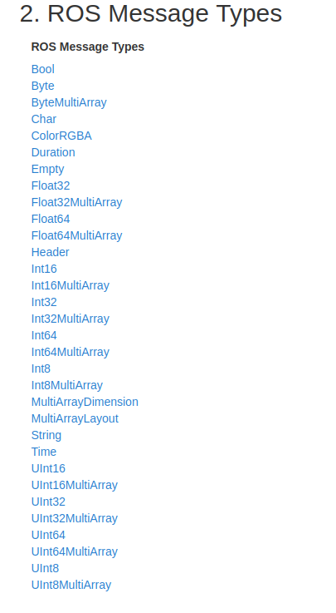
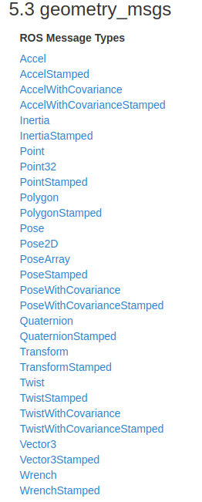
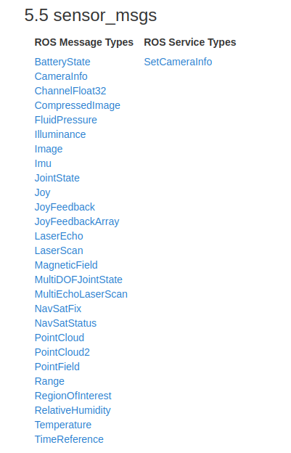
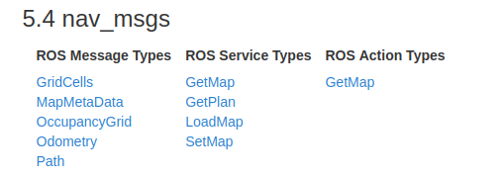
Sensor_msgs -> Image

Slide 3
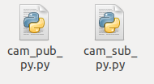
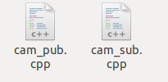
Folder structure
Simple_camera_publisher
scripts
src

Slide 4
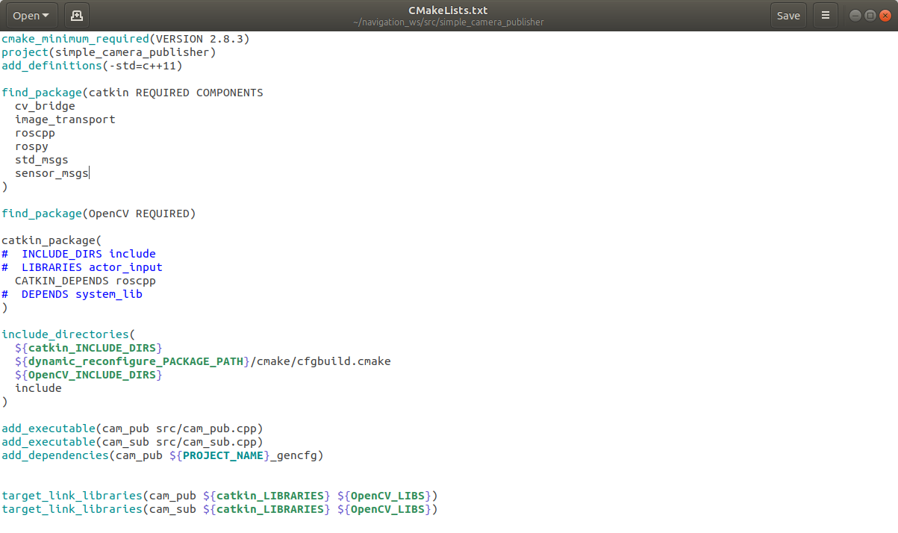







OpenCV and Image additions to CMakeLists.txt

Slide 5
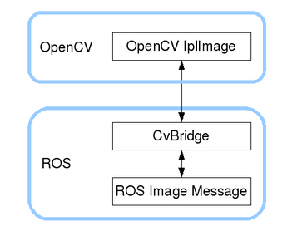






OpenCV and Image additions to CMakeLists.txt
ROS bridge to OpenCV

Slide 6
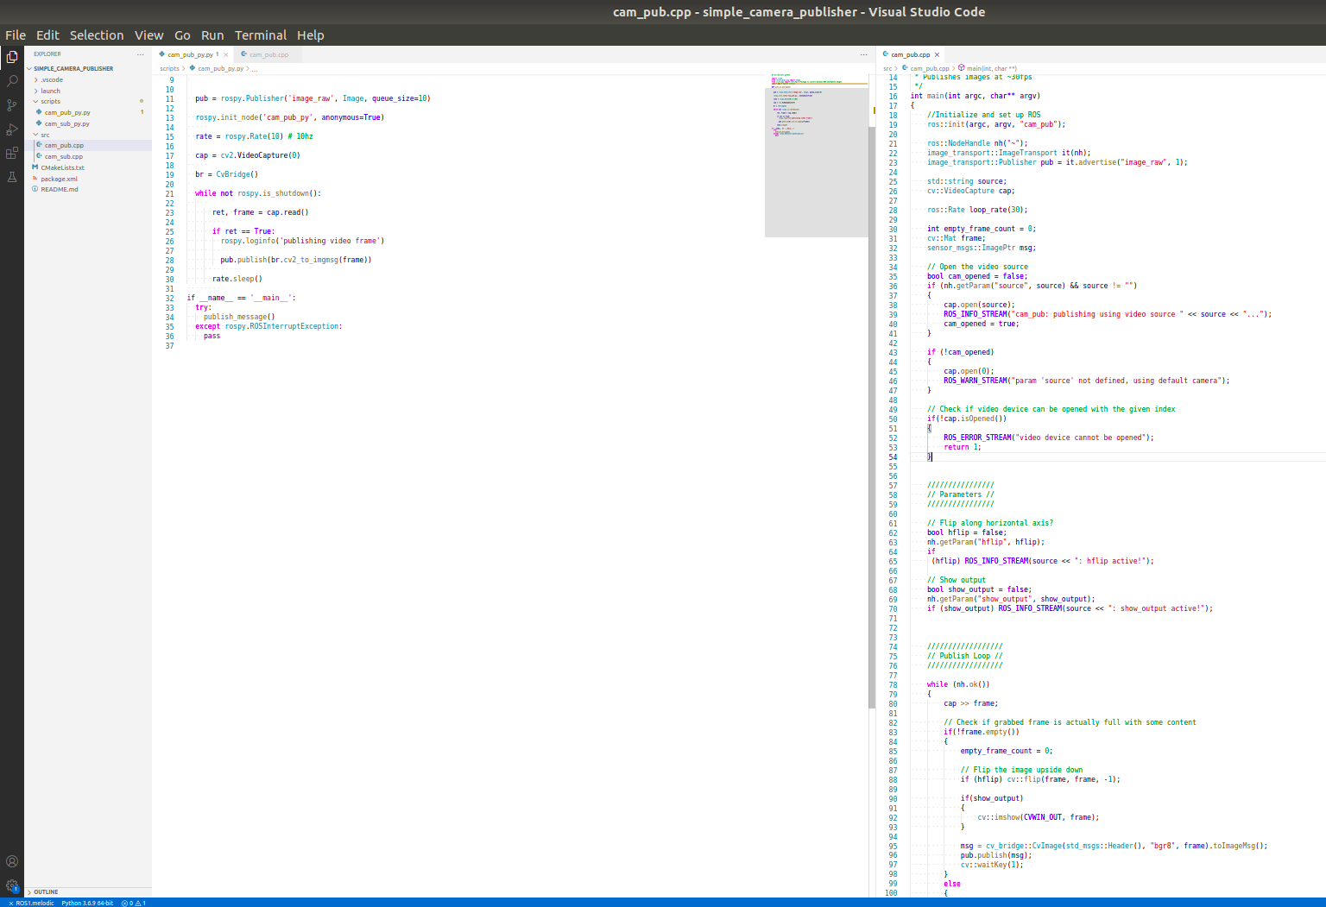

Slide 7
To run
C++
$ rosrun simple_camera_publisher cam_pub
$ rosrun simple_camera_publisher cam_sub
OR
Python
$ rosrun simple_camera_publisher cam_pub_py
$ rosrun simple_camera_publisher cam_sub_py

Slide 8
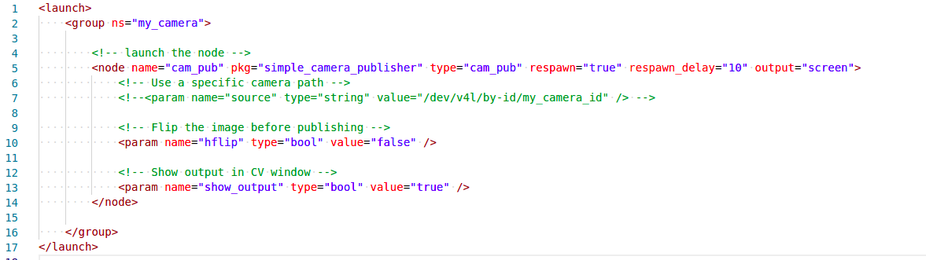




The launch files

Slide 9
Dynamic Reconfigure
http://wiki.ros.org/dynamic_reconfigure/Tutorials

Slide 10
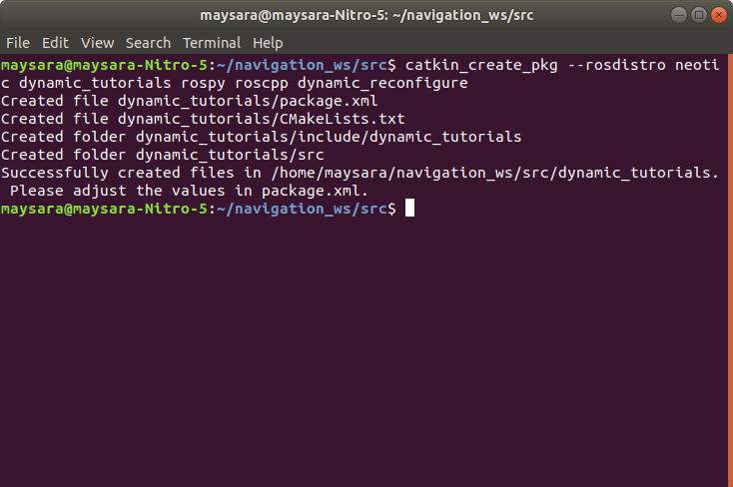
Initialize the package

Slide 11
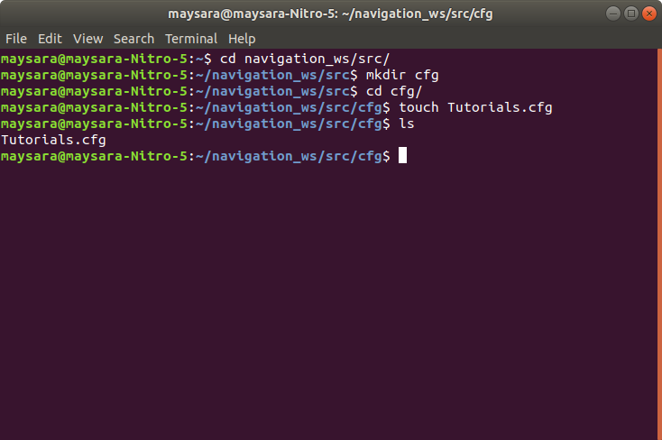
Make the cfg directory and file
cd navigation_ws/src/dynamic_tutorials/
mkdir cfg
Touch Tutorials.cfg

Slide 12
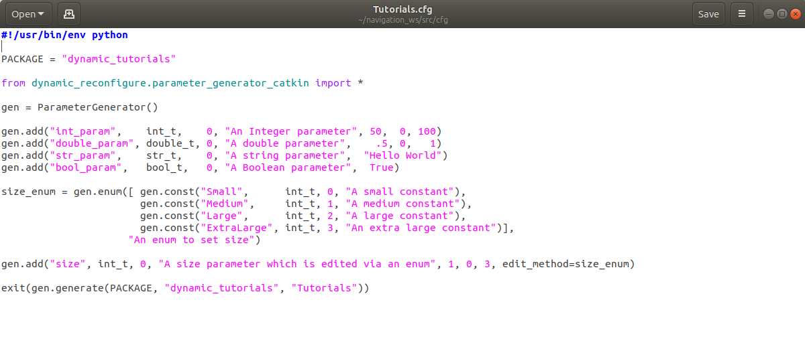
Fill in the following or copy and paste
And make it an executable
maysara@maysara-Nitro-5:~/navigation_ws/src/cfg$ chmod +x Tutorials.cfg

Slide 13
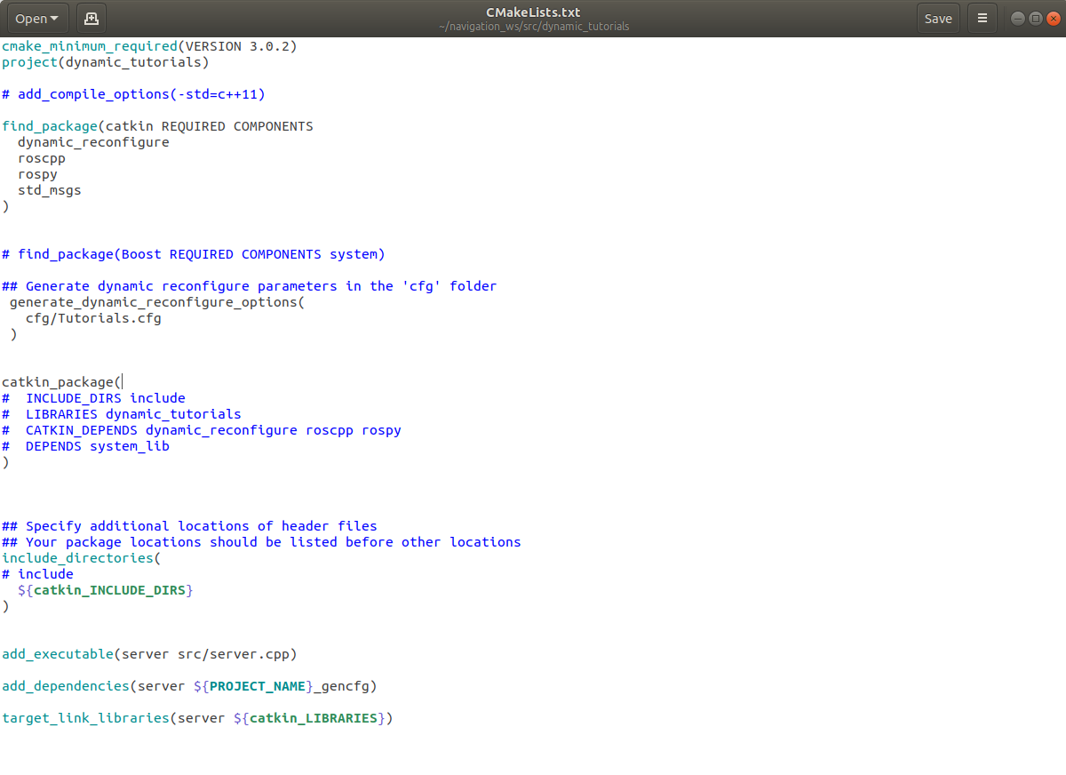



Edit the CMakeLists.txt
Must be between

Slide 14
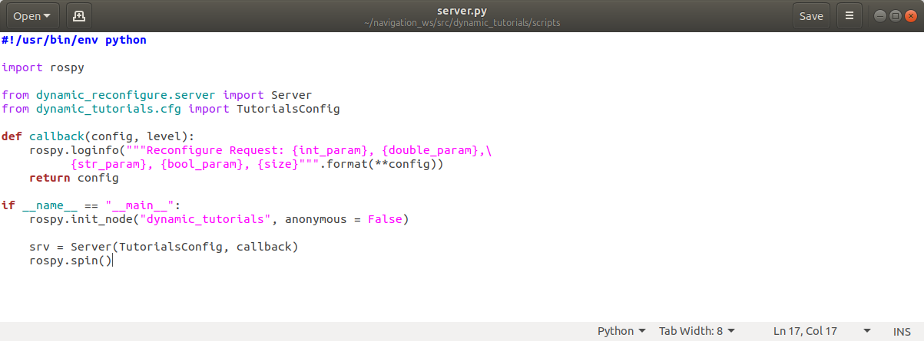
Create the scripts directory and server.py

Slide 15
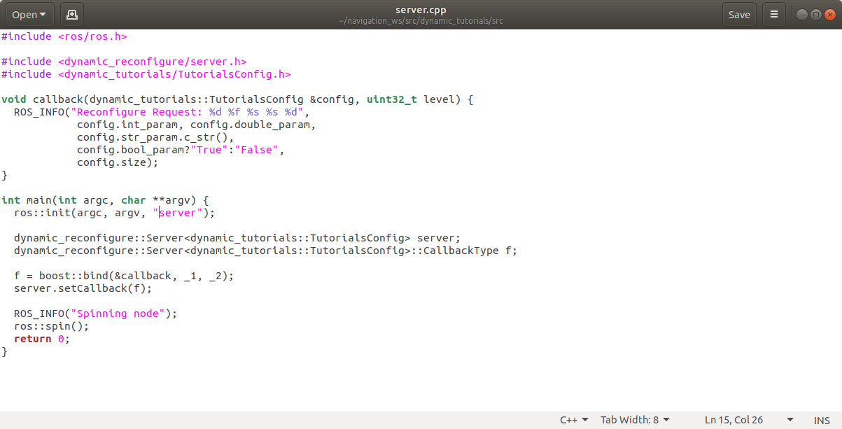
Create server.cpp file

Slide 16
catkin_make and run
$ rosrun dynamic_tutorials server
$ rosrun dynamic_tutorials server.py

